Slide 1
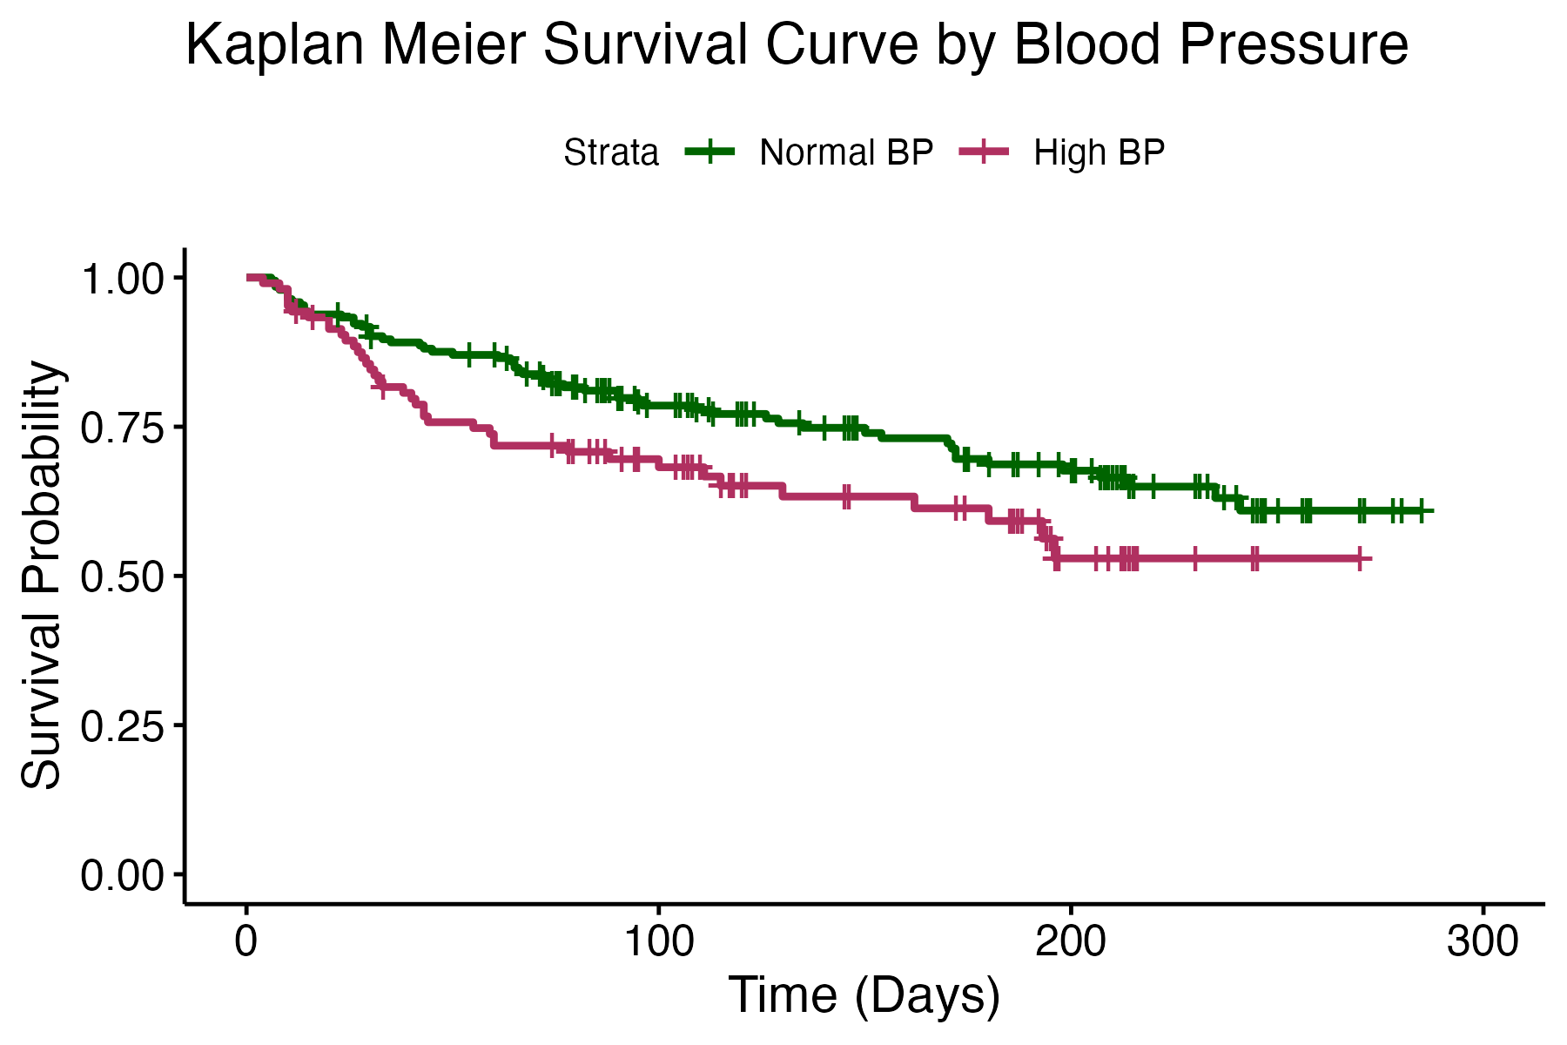
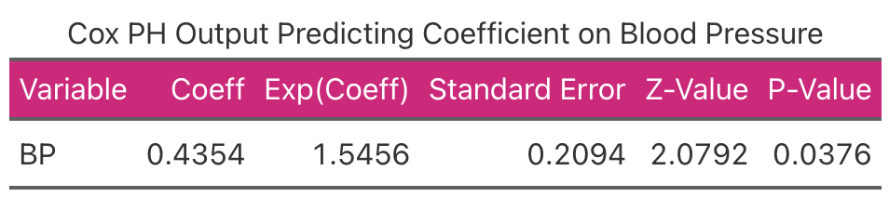
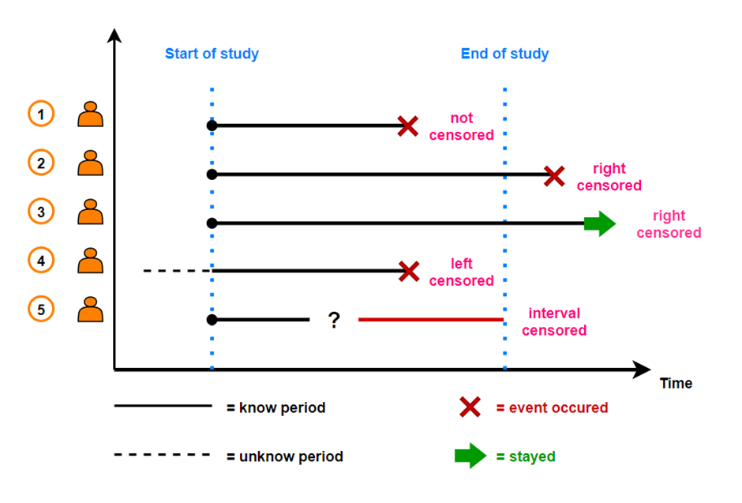
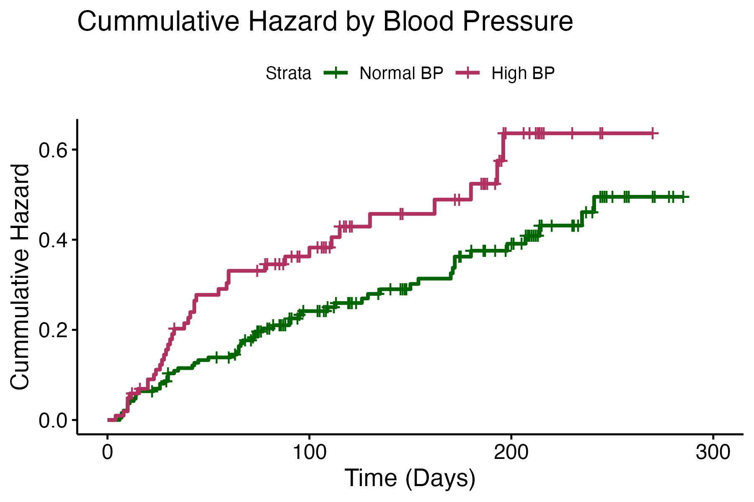
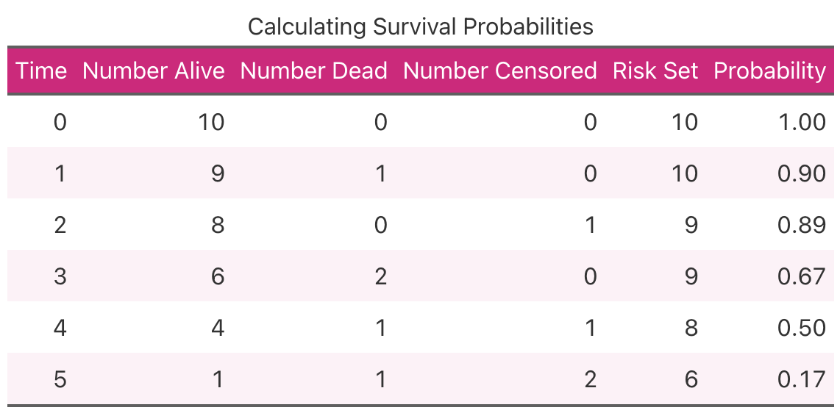
Introduction to Survival Analysis:
Modeling Medical Time-to-Event Data Using R Software Packages
Kristen Varin ‘24
Department of Mathematics, Computer Science, and Statistics at St. Lawrence University
Advised by Dr. Ivan Ramler
1. Survival Analysis
2. Kaplan Meier Curve
4. Log-Rank Test
Statistical analysis used for analyzing the relationship between time and an event of interest occurring for individuals (time-to-event data)
Medical events of interest include death, recovering from treatment, contracting a disease, etc.
Variables needed include id of the individual, time, and status (0 if the event has not occurred at that time for that individual; 1 if it has)
Objectives
Demonstrate Survival Analysis using Kaplan Meier Curves, Cox Proportional Hazards Analysis, and Log-Rank Tests
Use real case-study data to demonstrate medical applications
Use R packages to run analyses and create graphs
Curve that depicts relationship between time and probability of survival
Used only for univariate analysis (one variable at a time)
Best for visualizing the difference in survival probability between two groups
Statistical test to compare survival curves between two groups
Tests the null hypothesis that there is no difference between the survival estimates of two groups at any point in time
Compares the observed number of events to an estimated number of events for each group at each time
Uses a Chi-Square Test Statistic
Case Study: Heart Dataset
Data on heart failure patients over 40 years old
Event of Interest: Death of patient
Goal: See if Blood Pressure (Normal vs High) impacts time until death
Results
The Log-Rank test was significant (p = 0.04), meaning that the survival curves were different for the two blood pressure groups
Cox PH output in Table 2 shows that the hazard of death for heart failure patients with high blood pressure is estimated to be 1.55 times higher than the hazard of death for heart failure patients with normal blood pressure
In other words, at any given time, an individual with high blood pressure is 55% more likely to die than an individual with normal blood pressure
Censoring
When an individual’s event time is unknown, their survival time is censored
Three types of censoring can occur (see Figure 1):
Right censoring: individual is lost to follow-up after the study begins
Left censoring: individual is lost to follow-up before the study begins
Interval censoring: individuals come in and out of the study periodically
Figure 2. Kaplan Meier Curves for Two Groups of Heart Failure Patients
Table 2. Cox PH Output for Heart Failure Patients with Blood Pressure Predictor
R Packages Used
`survival()`: For creating survival objects and fitting models
`Surv`, Survfit`, `Suvdiff`
`ggsurvfit()`: For plotting survival curves using survival objects
`survminer()`: For plotting survival curves
`ggsurvplot`
3. Cox Proportional Hazard Analysis
Used to estimate the Hazard Ratio between two groups
Hazard Ratio: Risk of event in Group 1 / Risk of event in group 2
Risk of event = Probability of the event occurring for an individual in that group at any given point in time
Can be used for multivariate analysis (multiple predictors)
Assumes proportional hazards over time
5. Discussion
Figure 1. Depiction of Time-To-Event Data with Censored Observations (as adapted from https://medium.com/@Statistician_Leboo/introduction-to-survival-analysis-992cd4520d4f)
Can use Survival Analysis in other ways with medical data, such as for predicting recovery time from a treatment or disease reoccurrence
Can be an important tool for many disciplines that involve making decisions based on time-to-event analysis
Other applications of Survival Analysis include:
Epidemiology: predicting disease reoccurrence in a population
Finance: predict time until bankruptcy or loan repayment
Engineering: predict when a piece of equipment could fail
Marketing: predict when a customer will stop using a product
Insurance: predicting risk of death or property damage to improve insurance policies
Calculating Survival Probabilities
Probability of survival = # people alive at that time / Risk set (see Table 1)
Risk set = Total # of people in the study - # censored by that time
Data Source Cited
Ahmad, Tanvir, et al. “Survival Analysis of Heart Failure Patients: A Case Study.” PLOS ONE, Public Library of Science, 20 July 2017, journals.plos.org/plosone/article?id=10.1371%2Fjournal.pone.0181001.
Table 1. Probability of Survival Calculations Demonstration
Figure 3. Cumulative Hazard Curves for Two Groups of Heart Failure Patients

